Slide 1
Investor Analysis on Stock Market
Group: GO
Bivash Mainali(28913/078)
Sandesh Khatiwada(28936/078)

Slide 2
Introduction
Stock analysis is crucial for financial decision-making, but traditional methods often fall short in today's dynamic market.
Our project enhances stock analysis by using advanced simulation and modeling techniques to better understand market dynamics and predict outcomes.
By simulating different scenarios, our approach aims to improve investment strategies, leading to more informed and profitable decisions.

Slide 3
Problem Statement
The rapid changes and high volatility in the stock market make traditional analysis methods inadequate.
Our project focuses on advanced simulation and modeling to provide better tools and insights for navigating these challenges.
By leveraging big data and computational power, we aim to help investors make better-informed decisions in today's complex market environment.

Slide 4
Objectives
Analyze market trends through buying and selling pressure.
Demonstrate the benefits of simulation and modeling for better stock predictions.

Slide 5
Methodology
Requirement identification
Feasibility study
Tools

Slide 6
Requirement Identification
Identify the need for advanced stock analysis methods due to the limitations of traditional models in today's volatile market.
Ensure the capability to handle large datasets and complex computations for accurate and reliable predictions.

Slide 7
Feasibility Study:
Evaluate the availability of historical and real-time market data from reliable sources.
Assess the computational resources required for data processing, model training, and simulation.
Consider the scalability of the system to adapt to various market conditions and investor needs.

Slide 8
Tools
Data Loading and Pre-processing: Pandas, NumPy
Data Scaling: Scikit-Learn
Model Building and Training: TensorFlow (Keras)
Visualization: Matplotlib

Slide 9
High level design of proposed system
Use case
System flow chart

Slide 10
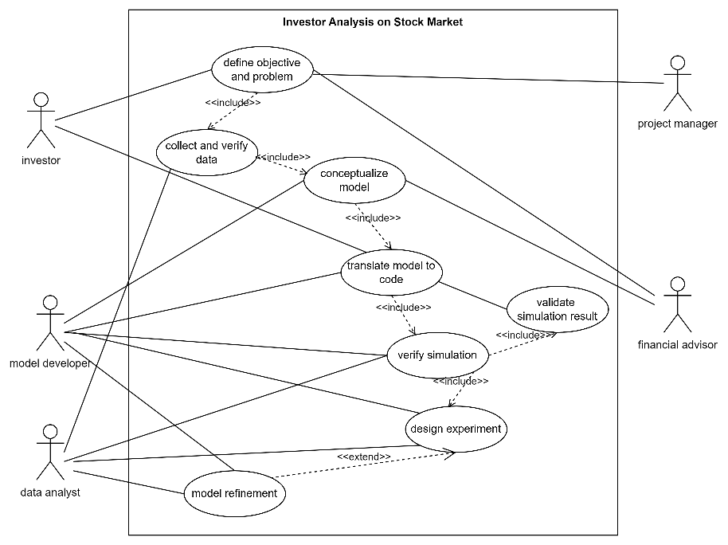
Use Case Diagram

Slide 11
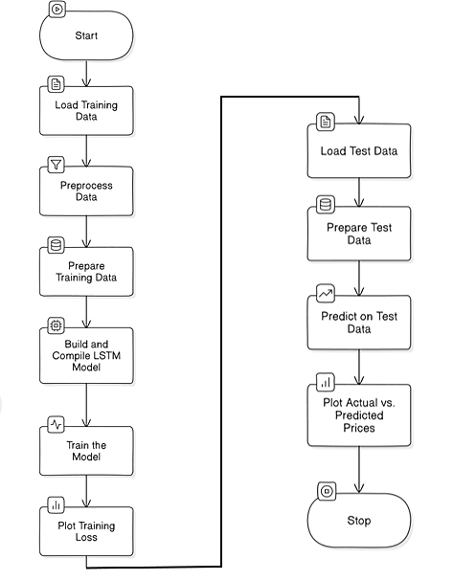
Flow Diagram

Slide 12
Project Planning

Slide 13
Expected Outcome
Data Loading and Pre-processing
Model Training
Training Loss Visualization
Model Evaluation
Prediction Visualization
Performance Assessment

Slide 14
